Slide 2
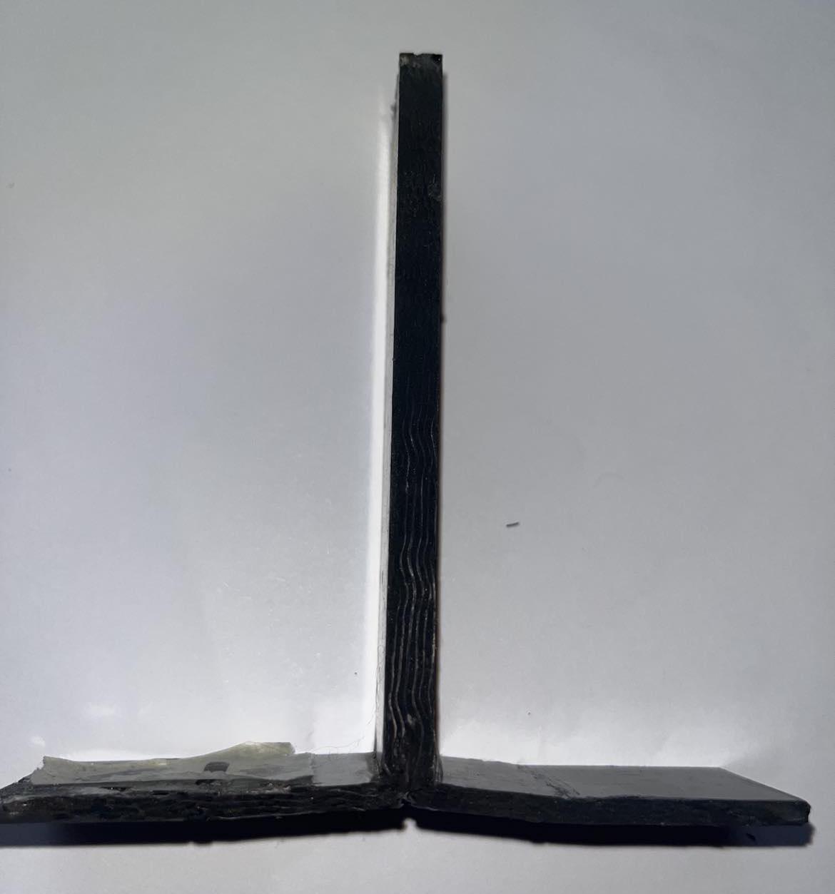
Matrix Crack

Slide 3
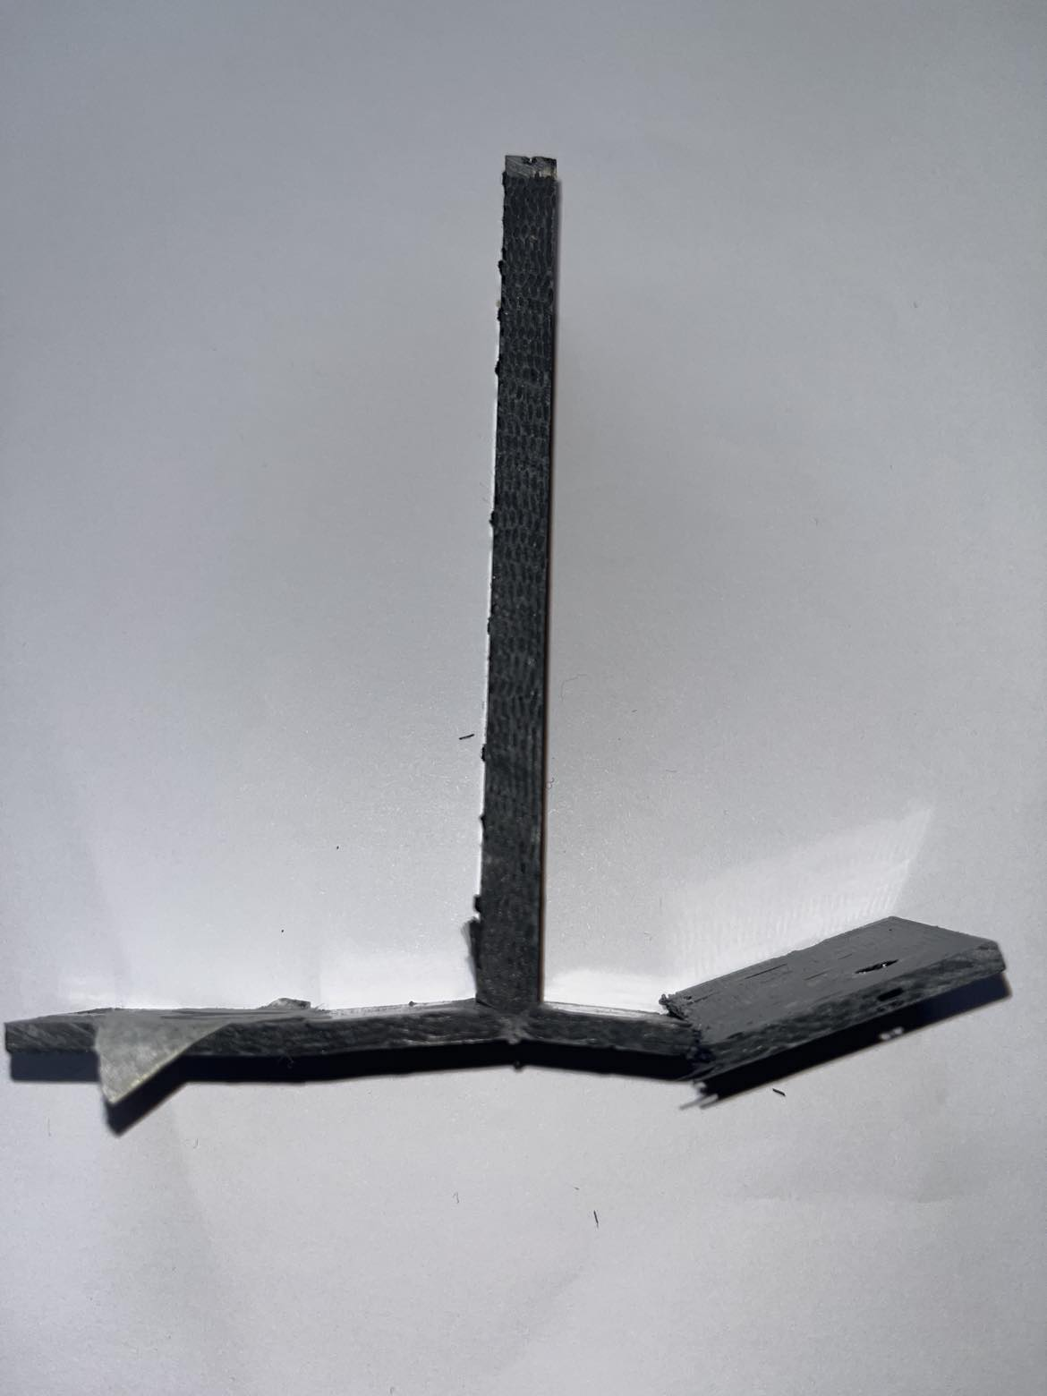
Flange Failure at Clamp

Slide 4
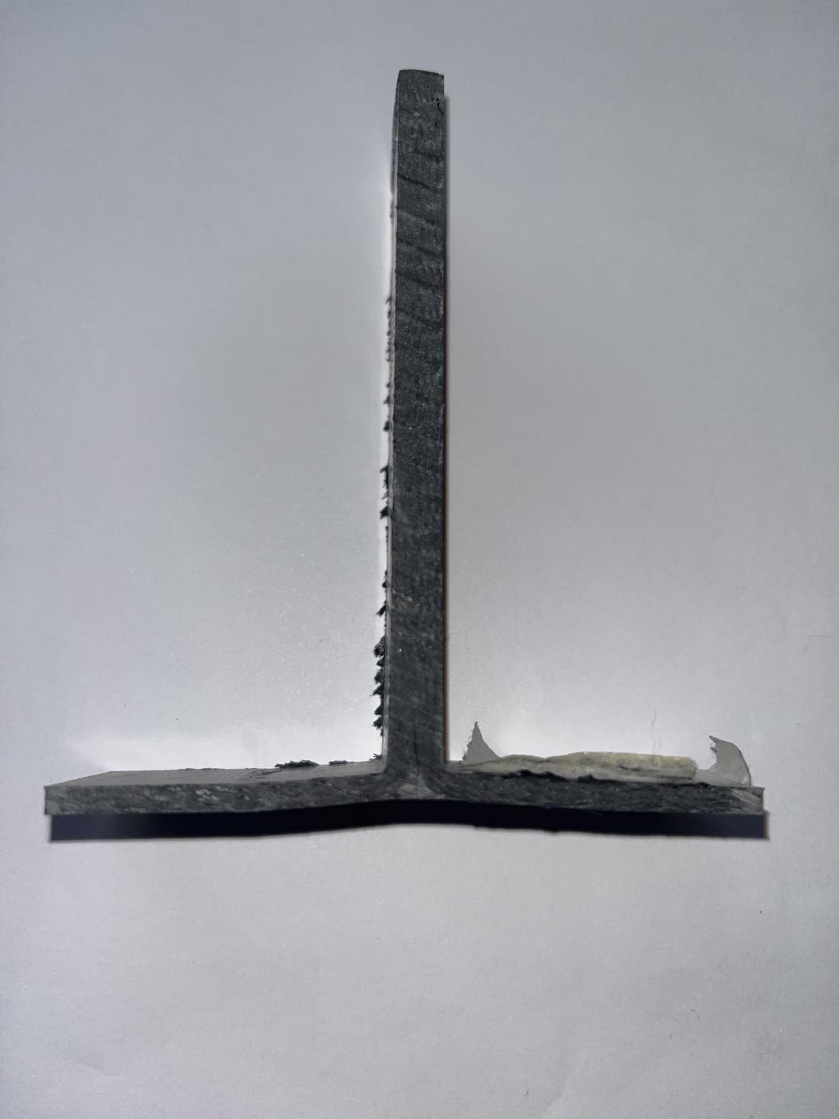
Matrix crack

Slide 5
START
Generate Population
Parameter strings to .dat eg. ”0 1 2 3 0 3 2 1 0 0 3 ….”
Generate TexGen Model
Run GenerateTextile.py
Evaluate Objective Function Values
Run CheckBinderPaths.py
Run FE analysis
Convergence?
Post-Process Results
NO
Calculate OFV
YES
END

Slide 6
TENSILE LOAD
FIXED

